Slide 1
Multimedia Systems Lecture – 25
By
Dr. Priyambada Subudhi
Assistant Professor
IIIT Sri City

Slide 2
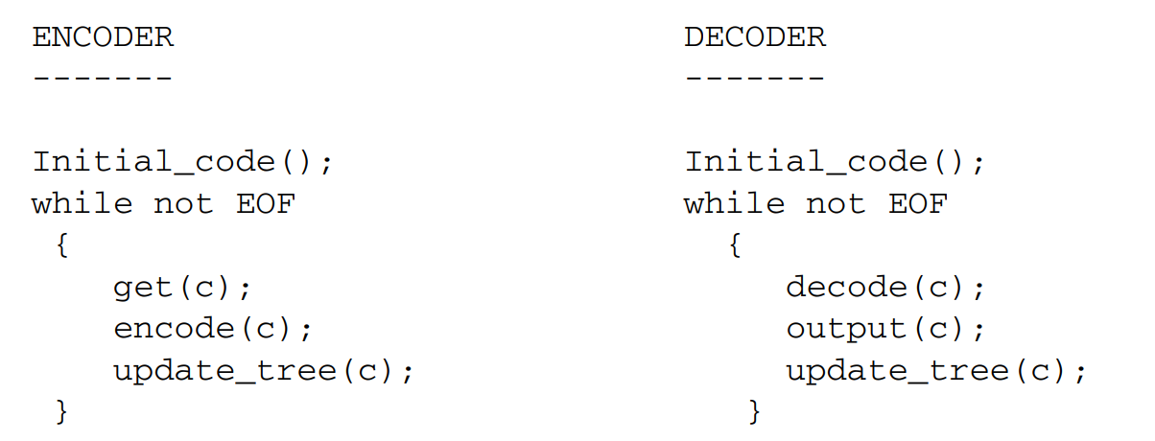
Procedure for Huffman Coding

Slide 3
Initial_code assigns symbols with some initially agreed-upon codes, without any prior knowledge of the frequency counts for them. For example, some conventional codes such as ASCII may be used for coding character symbols.
update_tree is a procedure for constructing an adaptive Huffman tree. It basically does two things: it increments the frequency counts for the symbols (including any new ones), and updates the configuration of the tree
The Huffman tree must always maintain its sibling property—that is, all nodes (internal and leaf) are arranged in the order of increasing counts. Nodes are numbered in order from left to right, bottom to top. If the sibling property is about to be violated, a swap procedure is invoked to update the tree by rearranging the nodes.
When a swap is necessary, the farthest node with count N is swapped with the node whose count has just been increased to N + 1. Note that if the node with count N is not a leaf-node—it is the root of a subtree—the entire subtree will go with it during the swap
The encoder and decoder must use exactly the same Initial_code and update_tree routines.

Slide 4
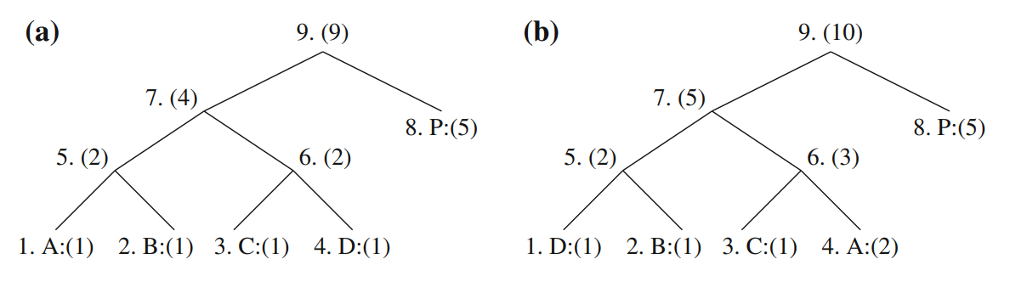
Node swapping for updating an adaptive Huffman tree: a a Huffman tree; b receiving 2nd ‘A’ triggered a swap;

Slide 5
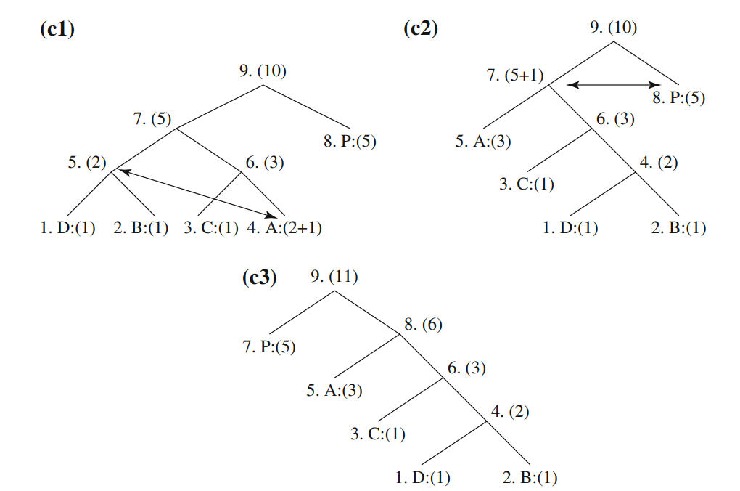
c1 a swap is needed after receiving 3rd ‘A’; c2 another swap is needed; c3 the Huffman tree after receiving 3rd ‘A’

Slide 6
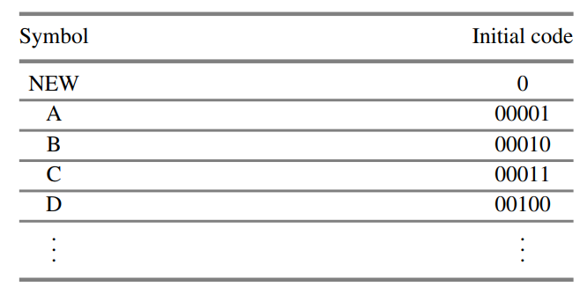
Example: Adaptive Huffman Coding for Symbol String AADCCDD.
Let us assume that the initial code assignment for both the encoder and decoder simply follows the ASCII order for the 26 symbols in an alphabet, A through Z.
To improve the implementation of the algorithm, we adopt an additional rule: if any character/symbol is to be sent the first time, it must be preceded by a special symbol, NEW. The initial code for NEW is 0. The count for NEW is always kept as 0.

Slide 7
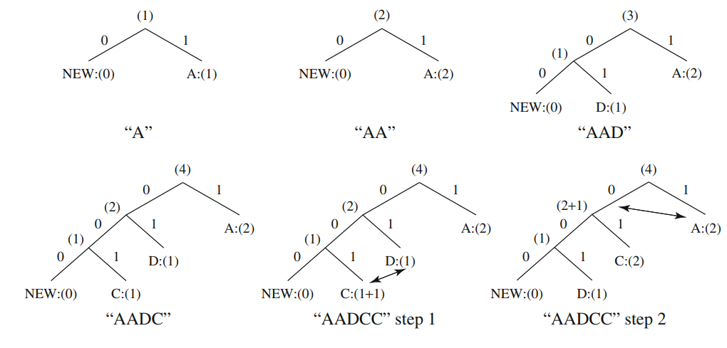
Adaptive Huffman tree for AADCCDD

Slide 8
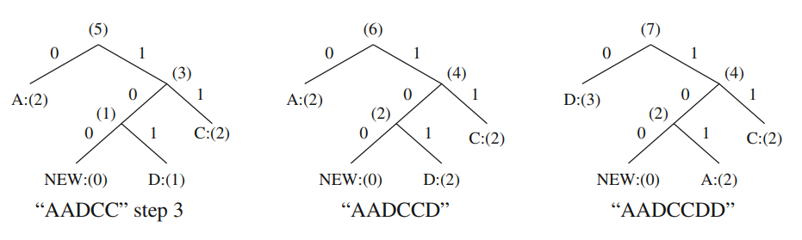

Slide 9
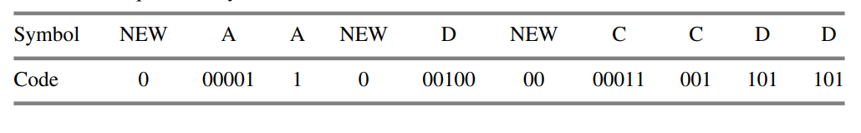
Sequence of symbols and codes sent to the decoder

